Slide 1
From experimental to clinical psychopathology:
the use of ECG to characterize mood disorders from a clinician perspective.
Claudio Gentili
University of Padua, Italy

Slide 3
My thesis on the contrary is that the bodily changes follow directly the PERCEPTION of the exciting fact, and that our feeling of the same changes as they occur is the emotion. Common sense says, we lose our fortune, are sorry and weep; we meet a bear, are frightened and run; we are insulted by a rival, are angry and strike. The hypothesis here to be defended says that this order of sequence is incorrect, that the one mental state is not immediately induced by the other, that the bodily manifestations must first be interposed between, and that the more rational statement is that we feel sorry because we cry, angry because we strike, afraid because we tremble, and not that we cry, strike, or tremble, because we are sorry, angry, or fearful, as the case may be. Without the bodily states following on the perception, the latter would be purely cognitive in form, pale, colourless, destitute of emotional warmth. We might then see the bear, and judge it best to run, receive the insult and deem it right to strike, but we could not actually feel afraid or angry.

Slide 4
… We have in every emotion as certain and manifest factors: (1) a cause, -- a sense impression, which acts as a rule by the aid of memory, or of an associated idea; -- and thereafter (2) an effect, namely, the previously discussed vasomotor changes, and further, issuing from them, the changes in the bodily and mental functions.
The question now arises: What lies between these two factors? Is there anything at all? If I begin to tremble because I am threatened with a loaded pistol, does first a psychical process occur in me, does terror arise, and is that what causes my trembling, palpitation of the heart, and confusion of thought; or are these bodily phenomena produced directly by the terrifying cause, so that the emotion consists exclusively of the functional disturbances in my body? …
We have … no absolute and immediate means of determining whether a sensation is of a psychical or bodily character. …Without doubt, the mother who sorrows over her dead child would resist, probably even become indignant, if anyone were to say to her, that what she feels, is the exhaustion and inertness of her muscles, the numbness in her bloodless skin, the lack of mental power for clear and rapid thought[2] ... There is no reason, however, for her to be indignant, for her feeling is just as strong, as deep and pure, whether it springs from the one, or the other source. But it cannot exist without its bodily attributes.
If from one terrified the accompanying bodily symptoms are removed, the pulse permitted to beat quietly, the glance to become firm, the color natural, the movements rapid and secure, the speech strong, the thoughts clear, -- what is there left of his terror?
Carl Lang 1885

Slide 5
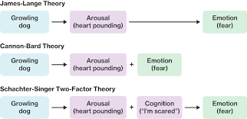

Slide 6
Depression
Depression is a common mental disorder, characterized by persistent sadness and a loss of interest in activities that you normally enjoy, accompanied by an inability to carry out daily activities, for at least two weeks. In addition, people with depression normally have several of the following: a loss of energy; a change in appetite; sleeping more or less; anxiety; reduced concentration; indecisiveness; restlessness; feelings of worthlessness, guilt, or hopelessness; and thoughts of self-harm or suicide.
DSM-5 symptoms of mania:
1. Depressed mood most of the day, nearly every day.
2. Markedly diminished interest or pleasure in all, or almost all, activities
3. Significant weight loss when not dieting or weight gain, or decrease or increase in appetite nearly every day.
4. A slowing down of thought and a reduction of physical movement (observable by others…).
5. Fatigue or loss of energy nearly every day.
6. Feelings of worthlessness or excessive or inappropriate guilt
7. Diminished ability to think or concentrate, or indecisiveness
8. Recurrent thoughts of death, recurrent suicidal ideation

Slide 7
Mania
An abnormally elevated mood state characterized by such symptoms as inappropriate elation, increased irritability, severe insomnia, grandiose notions, increased speed and/or volume of speech, disconnected and racing thoughts, increased sexual desire, markedly increased energy and activity level, poor judgment, and inappropriate social behavior. A mild form in mania that does not require hospitalization is termed hypomania.
DSM-5 symptoms of mania:
1. Inflated self-esteem or grandiosity
2. Decreased need for sleep (e.g., feels rested after only 3 hours of sleep)
3. More talkative than usual or pressure to keep talking
4. Flight of ideas or subjective experience that thoughts are racing
5. Distractibility (i.e., attention too easily drawn to unimportant or irrelevant external stimuli)
6. Increase in goal-directed activity (either socially, at work or school, or sexually) or psychomotor agitation

Slide 8
Mixed state
Full criteria are met for a manic or hypomanic episode, and at least three of the following symptoms are present during the majority of days of the current or most recent episode of mania or hypomania:
Prominent dysphoria or depressed mood as indicated by either subjective report (e.g., feels sad or empty) or observation made by others (e.g., appears tearful)
Diminished interest or pleasure in all, or almost all, activities (as indicated by either subjective report or observation made by others)
Psychomotor retardation nearly every day (observable by others; not merely subjective feelings of being slowed down)
Fatigue or loss of energy
Feelings of worthlessness or excessive or inappropriate guilt (not merely self-reproach or guilt about being sick)
Recurrent thoughts of death (not just fear of dying), recurrent suicidal ideation without a specific plan, or a suicide attempt or a specific plan for committing suicide.

Slide 9
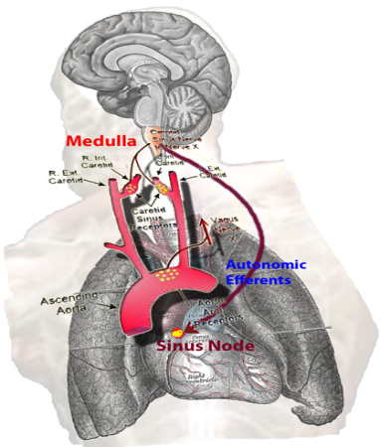

Euthymic
Depressed
(hypo)Mania
Mixed
ANS
measurments
ANS
measurments
ANS
measurments
Data Analysis
Data Analysis
Data Analysis
Data Analysis
ANS measurments
DATA analysis
DATA analysis
DATA analysis
DATA analysis
    Characterizing Different Mood States through
    Autonomic Nervous System Dynamics

Slide 10


Slide 11



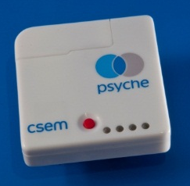

PSYCHE system
PSYCHE is a multidevice system based on:
A wearable (t-shirt) device for ECG, respiration and movement recordings
A SEW (electronic storage system)
A smartphone (data transmission, questionnaires and voice recording)
Data
base

Slide 12
Mood State Assessment using the PSYCHE SYSTEM
What can I do with it?
As a researcher: in evaluating the psychophysiological correlates of bipolar disorders
As a clinician; in helping in the assessment of the patients and in tailoring therapy
At a group level: understanding the common features in patients with mood disorders
At a single subject level: tailoring monitoring and intervention

Slide 13
Procedure
  Twice a week
  Voice:
    Baseline (3 mins)
    record: images description (on the smartphone)
    Baseline (3 mins)
    record: emotionally neutral text reading (on the smartphone)
    Baseline (3 mins)
  Mood Agenda and Bauer (smartphone)
  Clinical evaluations QIDS-C16, YMRS
  T-shirt monitoring

Slide 14
Subjects
  UNIPI (PISA): 11 subjects with bipolar disorders
  INSERM /UdS (STRASBURG) + UNIGE (GENEVA): 16 subjects
rapid-cycling bipolar disorders: 6 subjects
cyclothymic disorders: 4 subjects
cyclothymic temperaments : 6 subjects

Slide 15
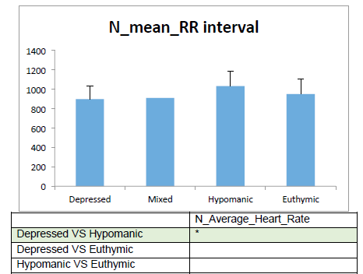
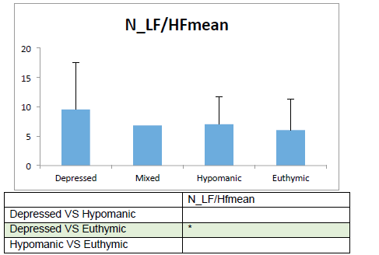
Characterize the patients at a group level
(results form the Strasbourg-Genève Studies)
ANS FEATURES

Slide 16
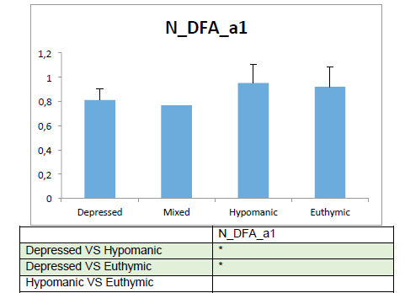
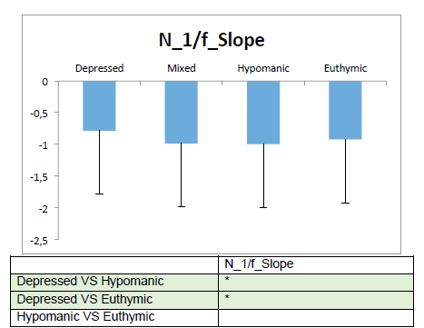
Characterize the patients at a group level
(results form the Strasbourg-Genève Studies)
LONG TERM AND NON LINEAR ANS FEATURES

Slide 17
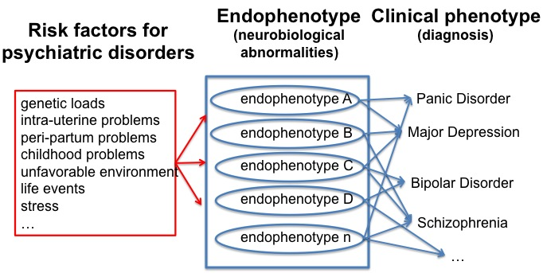
Characterize YOUR patient
(results form the Strasbourg-Genève Studies)
Why is it relevant?
Possible different endophenotypes and phenotypes
A hell for researchers an opportunity for clinicians

Slide 18
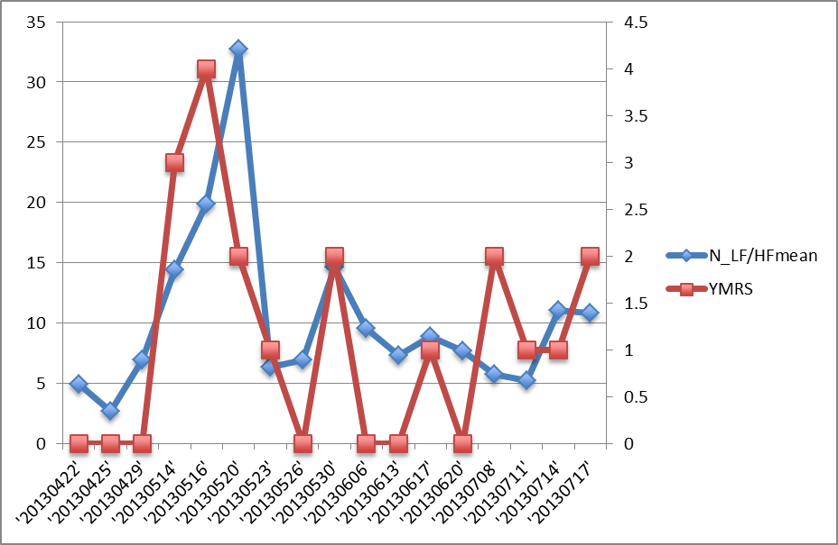
Characterize YOUR patient
(results form the Strasbourg-Genève Studies)
GEN03 R:=0,61249 p=0,00899566
LF/HF
YMRS

Slide 19
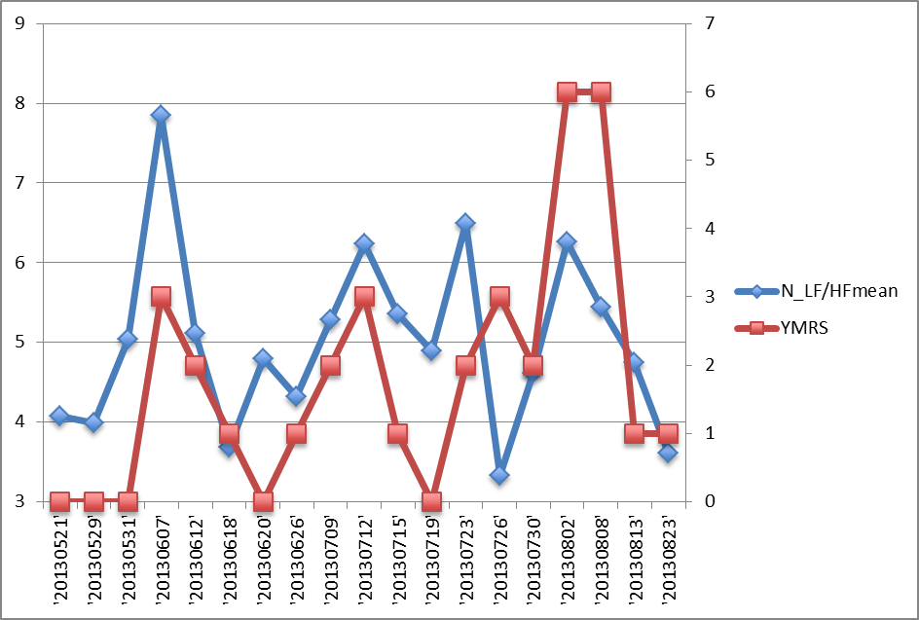
Characterize YOUR patient
(results form the Strasbourg-Genève Studies)
STR01 R=0.45955 p = 0.047764
LF/HF
YMRS

Slide 20
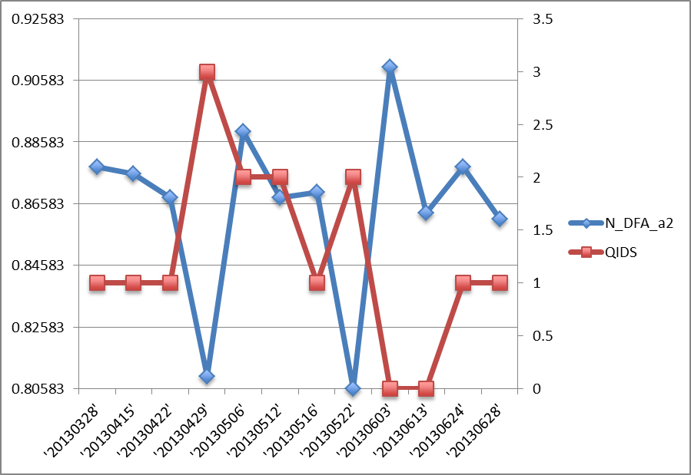
Characterize YOUR patient
(results form the Strasbourg-Genève Studies)
GEN01 R =- 0.65147 p = 0.021731
DFA 2
QIDS

Slide 21
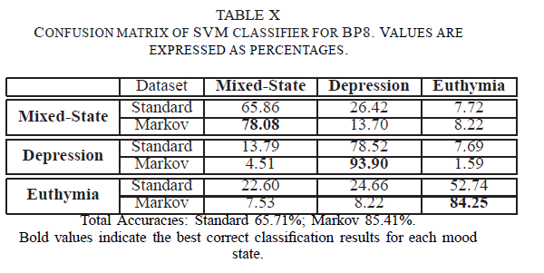
Characterize the patients at the subject level
ANS Features analysis summary
Valenza et al.,2014

Slide 22
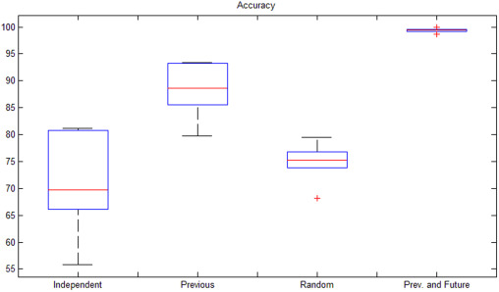
Characterize the patients at the subject level
ANS Features analysis summary
Gentili et al., 2017

Slide 23
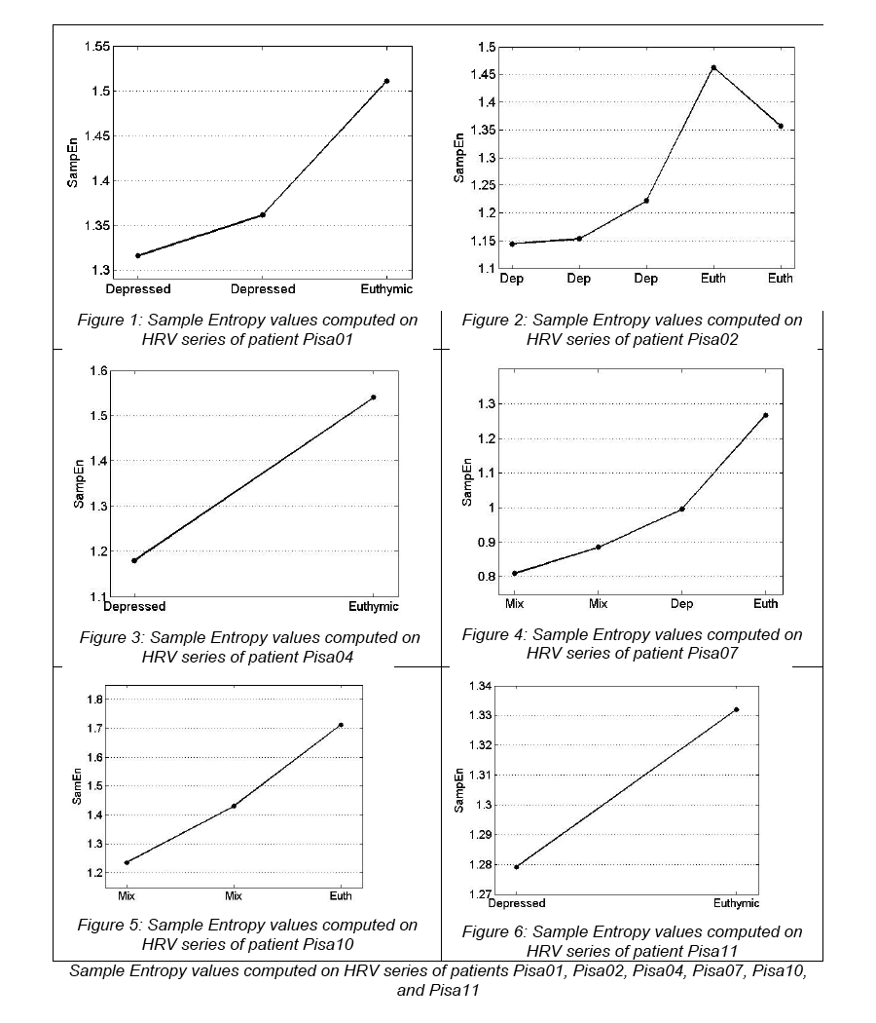
Monitoring of mood fluctuations
Sample Entropy
Euthymia vs.
Non euthymia
P < 0.003
95% CI
Euthymia:
[1.347, 1.563]
Non-euthymia:
[1.071, 1.264]
Lanatà et al., 2015
Notes:
Dire che psyche è basato su approccio multiparametrico. D’altro canto abbiamo la personalizzazione. Quindi il sistema è flessibile.
Un risultato interessante su questo PARTICOLARISSIMO campione di pazienti (gravi, ricoverati etc) abbiamo trovato questi trend

Slide 24
Personalized Mood State prediction in Bipolar Patients: Definitions
Psychophysiological
Transition
Psychophysiological
Transition
Psychophysiological
Transition
Mood
State
k₁
Mood
State
k₂
Mood
State
k₃
Mood
State
k_{N}
?
…..
Current
Observation
Prediction
Past Observations
Observations are intended as HRV recordings
during unstructured activities through the PSYCHE system
2 classes: EUTHYMIA vs. NON-EUTHYMIA
Valenza et al., 2016

Slide 25
Personalized Mood State prediction in Bipolar Patients
Valenza et al., 2016
PATIENT | NUM ACQ | INITIAL TRAINING | ACCURACY
STR01 (Cyclothymic disorder) | 22 | 1:5 (V0:V6) | 70.6%
STR02 (Cyclothymic disorder) | 18 | 1:3 (V0:V2) | 75%
STR03 (Cyclothymic disorder) | 14 | 1:9 (V0:V19) | 60%
STR04 (Cyclothymic disorder) | 15 | 1:3 (V0:V2) | 83.33%
STR05 (Bipolar disorder) | 8 | 1:3 (V2:V7) | 60%
STR06 (Bipolar disorder) | 19 | 1:4 (V0:V3) | 73.33%
STR07 (Cyclothymic temperament) | 22 | 1:4 (V0:V5) | 77.78%
STR08 (Cyclothymic temperament) | - | - | -
STR09 (Cyclothymic temperament) | 10 | 1:3 (V4:V6) | 42.85%
GEN01 (Cyclothymic temperament) | 18 | 1:5 (V12:V18) | 70%
GEN02 (Bipolar disorder) | 12 | 1:3 (V12:V14) | 80%
GEN03 (Bipolar disorder) | 18 | 1:3 (V3:V5) | 66.67%
GEN04 (Bipolar disorder) | 8 | 1:3 (V8:V10) | 66.67%
GEN05 (Cyclothymic temperament) | 16 | 1:9 (V0:V11) | 71.43%
GEN06 (Bipolar disorder) | 8 | 1:3 (V7:V9) | 66.67%

Slide 26
Personalized Mood State prediction in Bipolar Patients
Results over the group
Possible reason:
The subjective
Well class
is under-represented
(about 20% of the
observed states)
Sensitivity | 57%
Specificity | 78%
Positive predictive value | 60%
Negative predictive value | 76%
Average Accuracy | 71.94%
Valenza et al., 2016

Slide 27
Future directions for clinicians
Why this is useful to clinicians?
PSYCHE system is based on affordable technology (smartphone and app) and highly diffuse psychophysiological tools (ECG)
ECG was recorded with a long-lasting procedure and a wearable system however the necessity of a wearable system appears to be not mandatory
Of course some form of telemonitoring would increase the value of the information gathered through psychophysiology (screening evaluation of patients’ wellbeing without the necessity of professional consultation
Forecasting relapses might reduce negative outcomes in bipolar disorders (e.g., suicide behavior) and provide a more rapid onset of effective treatments and may have impacts on healthcare policy
Notes:
La 3 la puoi anche togliere se vuoi…era per dire che se io ho una idea di quando il paziente starà meglio posso pensare, per tempo, alla dimissione e a ricoverare qualcun altro

Slide 28
Thirty-one patients admitted to cardiac rehabilitation after first-time cardiac surgery were recruited.
Depressive symptoms were assessed with the Center for Epidemiologic Studies Depression Scale (CES-D).
HRV features in time, frequency, and nonlinear domains were extracted from 5-min-ECG recordings at rest and used as predictors of “least absolute shrinkage and selection” (LASSO) operator regression model to estimate patients' CES-D score and to predict depressive state.

Slide 29
Reduced HRV in depressed patients with heart surgery
Depressed
Controls
Depressed
Controls
Patron, et al. (2012)

Slide 30
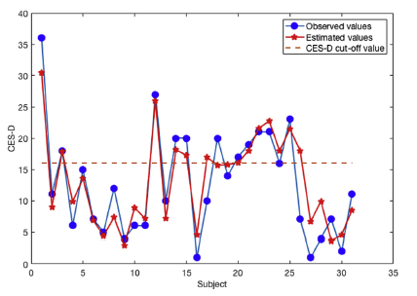

multi-features and single-subject analysis
(Gentili, et al., 2017)

Slide 31
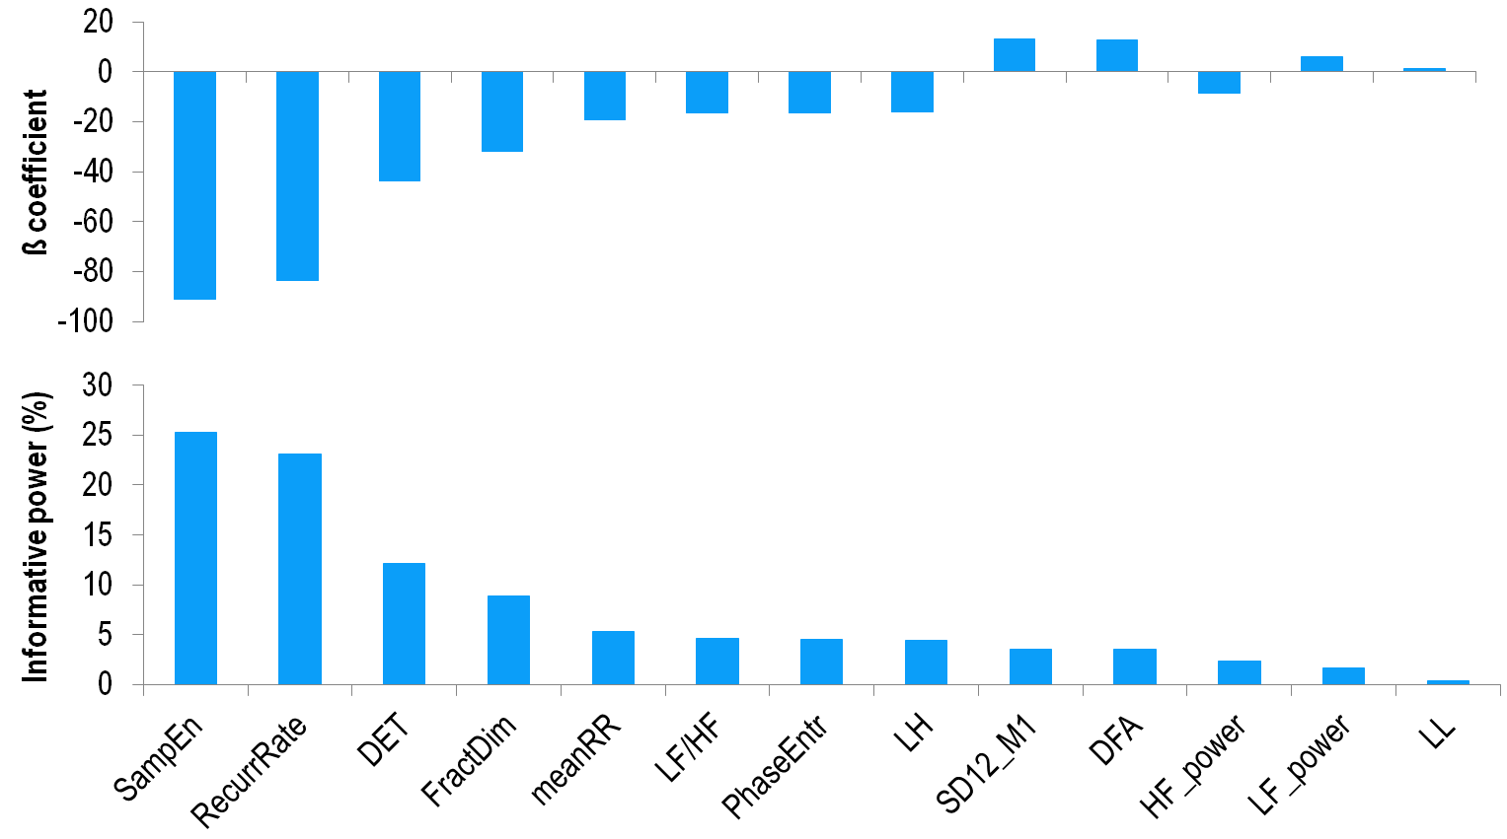
Relative weights of HRV metrics in the LASSO model
Non linear measures explain over 50% of the model
(Gentili, et al., 2017).

Slide 32
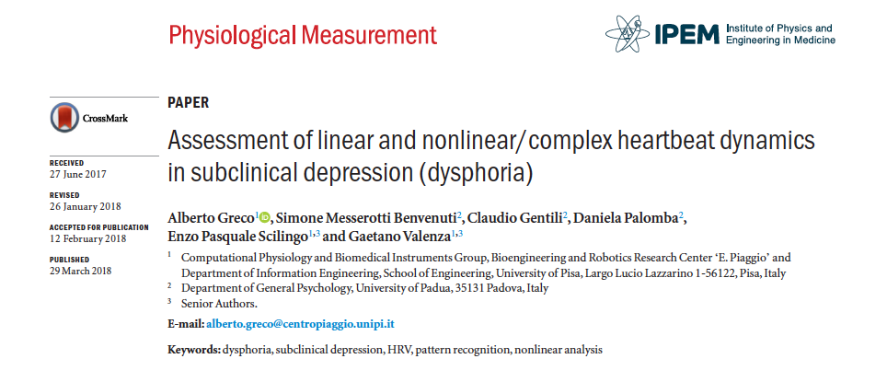
Is there a similar relation between HRV and depression in non cardiac population?

Slide 33
Methods
224 screened students
24 dysphoric subjects (all females)
(BDI > 12; symptoms of depression >2 but <5
36 controls (all females)
(BDI < 8)
5-min basal ECG
Supported Vector Classification with Leave One Out
LASSO regression with Leave One Out
Greco et al. 2018

Slide 34

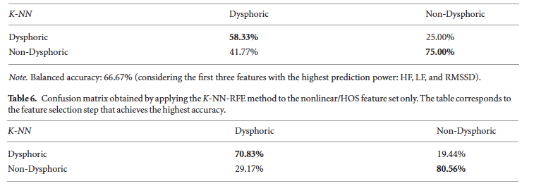
Results
All features
Linear Features
Non-linear features
Greco et al. 2018

Slide 35
Confirmatory on going study
168 individuals (75 dysphoric)
From three different studies (3 o 5 mins of basal ECG )
Results (only linear features considered)
Accuracy for the SVC 0.73
Prediction of the BDI-II: 0.14 R²
classification
Dysphoric
Controls
Dysphoric
48
27
diagnosis
Controls
18
75

